Slide 1

Exploratory Data Analysis
Pima Indians Diabetes Dataset
Machine Learning - Group

Slide 2
Danh sách thành viên
MSSV | Họ tên thành viên | Nhiệm vụ
3123410260 | Đỗ Nguyễn Thanh Phong (Leader) | Viết báo cáo, tổng hợp thông tin và code, phân tích dữ liệu
3123410148 | Dương Chí Khang | Viết code minh họa
3123410383 | Trịnh Minh Toán | Viết code minh họa
3123410312 | Cao Thanh Tài | Phân tích dữ liệu và tìm kiếm thông tin

Slide 3
Agenda
Introduction & Motivation Dataset Summary Feature Description Univariate Analysis Outcome-wise Analysis Missing Values & Irregularities | Feature Relationships Key Questions Correlation Heatmap Integrated Insights Conclusion References

Slide 4

Introduction & Theoretical Background
WHO (1999):
Diagnostic thresholds: FPG ≥ 126 mg/dl; OGTT 2h ≥ 200 mg/dl.
Defines IFG, IGT, and Metabolic Syndrome.
ADAP (1988):
First neural network applied to this dataset.
Achieved ~76% sensitivity and specificity.
-cell Research (recent):
Explores regenerative therapies for insulin-producing cells.
Motivation: Diabetes is multifactorial → need clinical criteria, predictive AI, and novel therapies.

Slide 5
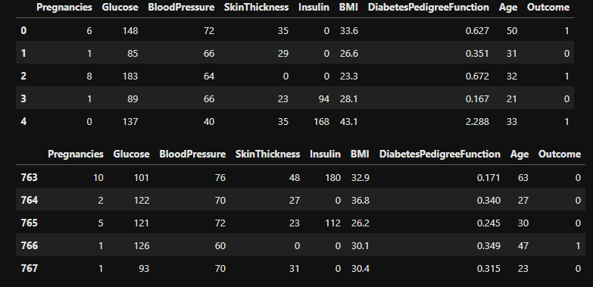
Dataset Summary
Source: NIDDK, Pima Indian women (≥21 years).
Size: 768 cases, 8 features + 1 target.
Target variable (Outcome):
0 = No diabetes (65%)
1 = Diabetes (35%)
Relevance to WHO: Variables match clinical risk factors (glucose, BMI, BP, family history).

Slide 6
Feature Description
Pregnancies: Risk of gestational diabetes.
Glucose (2h OGTT): WHO diagnostic gold standard.
Blood Pressure: Component of Metabolic Syndrome.
Skin Thickness & BMI: Measures of obesity.
Insulin (2h): Indicator of insulin resistance.
DPF: Family/genetic risk index.
Age: Risk increases with age.
Outcome: Target variable (0/1).

Slide 7
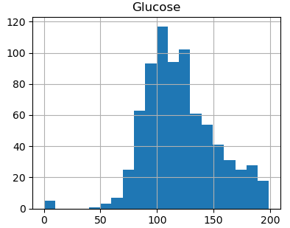
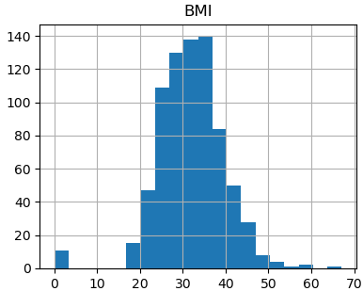
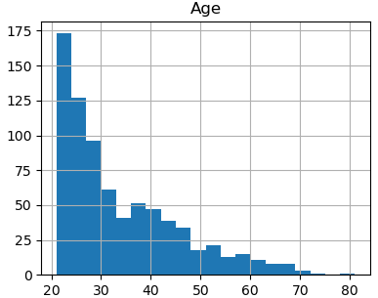
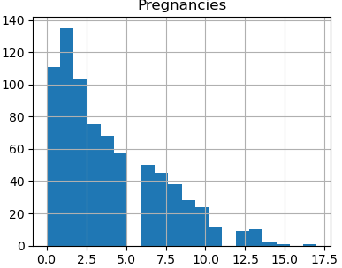
Univariate Analysis (Distributions)
Glucose: Right-skewed; many exceed WHO thresholds.
BMI: Mean ~32, majority overweight/obese.
Age: Mostly 20–40 years.
Pregnancies: Majority < 6, some > 10.

Slide 8
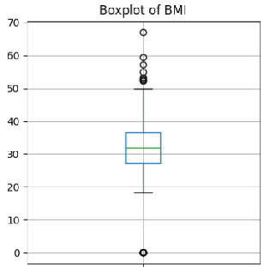
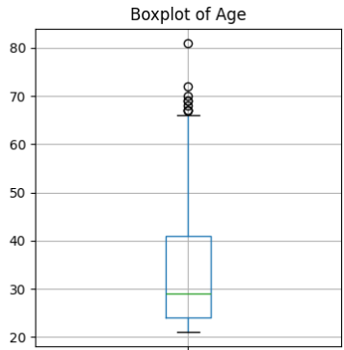
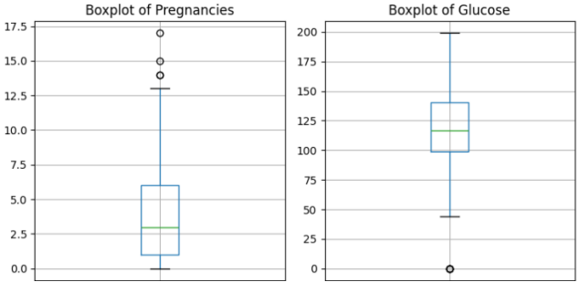
Outcome-wise Analysis
Glucose: Diabetic ~141 vs Non-diabetic ~110 mg/dl.
BMI: Diabetic ~35 vs Non-diabetic ~31.
Age: Diabetic ~37 vs Non-diabetic ~31.
Pregnancies: Slightly higher in diabetic group.
WHO Link: Confirms obesity + hyperglycemia as main risk factors.
ADAP Link: Variables show clear separability → useful for prediction.

Slide 9
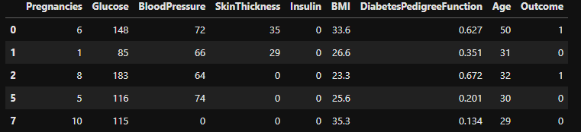
Missing Values & Irregularities
Variables with implausible zeros:
Blood Pressure = 0 (not possible).
Skin Thickness = 0 (missing).
Insulin = 0 (missing).
Interpretation: These are not real values → represent missing measurements.
Impact: May bias statistical analysis; require imputation or exclusion.

Slide 10
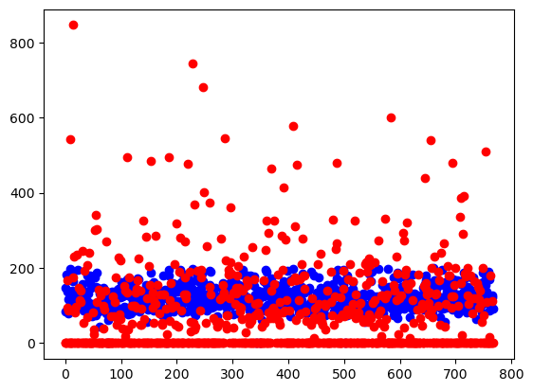
Feature Relationships
Pregnancies ↔ Age: Older → more pregnancies.
BMI ↔ Skin Thickness: Both proxies for body fat.
Glucose ↔ Insulin: Both reflect metabolic dysfunction.
WHO Link: Mirrors Metabolic Syndrome (glucose + obesity + BP).
ADAP Link: Captures these nonlinear associations in prediction.

Slide 11
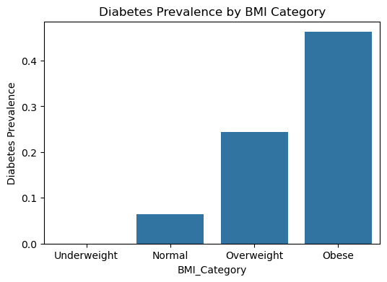
Key Questions
At what glucose threshold does diabetes prevalence surge? (WHO: ≥200 mg/dl OGTT).
Do obese patients (BMI ≥ 30) show higher prevalence?
How does age progression shift diabetes risk?
Which combination of factors best predicts outcome?

Slide 12
Correlation Heatmap
Glucose = strongest correlation with Outcome.
BMI, Age, DPF = moderate correlation.
Insulin, SkinThickness = weak (many missing values).
WHO validation: Confirms glucose & obesity as main predictors.
ADAP validation: Input variables align with model’s best predictors.

Slide 13
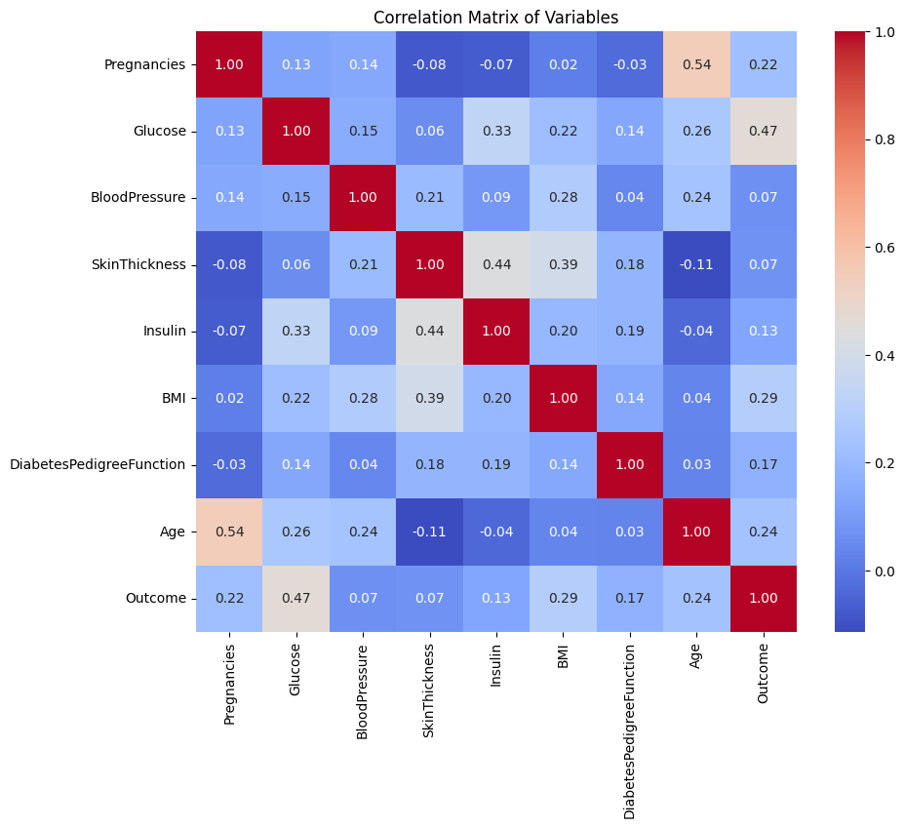

Slide 14
Integrated Insights (WHO – ADAP – -cell)
WHO (1999): Defines thresholds & clinical risk factors (glucose, BMI, BP, age).
ADAP (1988): Proved AI can use these variables to forecast diabetes (76% accuracy).
-cell Research: Aims at regenerating insulin-producing cells → long-term treatment.
EDA Findings:
Glucose, BMI, Age strongly separate diabetic vs non-diabetic groups.
Pima dataset mirrors WHO criteria → valid for both clinical and AI studies.
Dataset highlights current gaps (missing insulin data) relevant for -cell research.

Slide 15
Dimension | WHO (1999) | ADAP (1988) | -cell Research | EDA Evidence
Objective | Define diagnostic thresholds | Predict diabetes risk | Regenerate insulin cells | Confirm patterns in data
Key Variables | Glucose, BMI, BP, Age | 8 predictors (Pima) | Genes, PDX1, NGN3 | Glucose, BMI, Age strongest
Strengths | Clinical standard | Early AI breakthrough | Future therapeutic potential | Validates both WHO & ADAP
Limitations | Not personalized | Limited accuracy | Mostly animal studies | Missing values, outliers

Slide 16
Conclusion
EDA confirms: Glucose, BMI, Age, family history are key predictors.
Dataset bridges clinical guidelines (WHO) and AI prediction (ADAP).
Provides valuable ground for both epidemiological studies and machine learning models.
Future: Integration with -cell therapy research could connect prediction → prevention → treatment.

Slide 17
References
WHO (1999). Definition, Diagnosis and Classification of Diabetes Mellitus.
Smith et al. (1988). Using the ADAP learning algorithm to forecast diabetes mellitus. IEEE Comp Soc Press.
WHO. Classification of Diabetes Mellitus and Glucose Intolerance.
UCI ML Repository – Pima Indians Diabetes Dataset.

Slide 18
Thank You All

